Slide 1
Prepayment Model
August 2014

Slide 2
Prepayment In Residential Mortgage
What is Prepayment
A mortgage is a loan contract with a certain repayment schedule. This schedule will establish a monthly cash flow to payoff the debt. The activities that may accelerates the repayment schedule, resulting in extinguish the mortgage contract earlier, is called a prepayment.
Mortgage Contract
Establish repayment schedule
Cash Flow
accelerates the repayment schedule
Prepayment
Four kinds of prepayment activities
Curtailment / Full payment: Send more than the scheduled monthly payment
Refinancing: replaces the mortgage with a new one
Turnover: home sales prepayment
Default: borrower fail to fulfill the scheduled term of the mortgage
Why Prepayment Model is important
Our Goal
Key
Foundation
MBS Valuation
Estimate Cash Flow
Prepayment Model
Investor in a MBS has a short position in a call option due to the homeowners’ right to prepay, a put option due to the homeowners may default, and also a long position in a non-callable bond. The prepayment behavior will change the cash flow of the MBS then vary its value. So the key to estimate the value of MBS is to accurately estimate its cash flow. And a decent prepayment model will definitely be the foundation of the cash flow estimation.

Slide 3
What is Prepayment Model
Prepayment Model with Sub-components
A prepayment model is a model to describe and predict the homeowners’ prepayment behavior.
We analyze the four kinds of prepayment separately and then combine their influence together.
Prepayment
Activities
Quantitative Prepayment Speed
Refinancing
Curtail
?
Turnover
Default
✓
Measuring Prepayment Rates
Use rates like SMM, CPR and PSA rate to describe the prepayment speed.
SMM converts the dollar amount into prepayment rate per dollar.
CPR is the corresponded annual value.
PSA uses a benchmark prepayment curve.

Slide 4
Inputs of prepayment model
What inputs does a prepayment model need
Borrower Characteristics
Factor | Input name | Comments
Credit Score | FICO | Credit Scoring
Input of
Prepayment
Model
Loan Characteristics
Loan Size | ACLS | Average Loan Size
Loan Rate | WAC | Weighted Average Coupon
Loan Age | WALA | Seasoning
Loan Equity | LTV | Loan to Value Ratio
Pool Factor | Burnout | Current to Original Balance Ratio
Macro Economic Variable
Housing Mkt | HPA | Home Price Appreciation
Mortgage Rate | PMM | Mortgage Rate
Seasonal | SEASON | Seasonality
Total SMM = curtailment SMM + default SMM + turnover SMM + refinance SMM
Input Parameter |  | Curt | Dflt | Turn | Refi
Borrower | FICO |  | • |  | •
Loan | ACLS |  |  |  | •
 | WAC |  |  | • | •
 | WALA | • | • | • | •
 | LTV |  | • | • | •
 | Burnout |  |  |  | •
Macro-Economic | HPA |  |  | • | •
 | PMM |  |  | • | •
 | SEASON |  |  | • | •

Slide 5
Modeling Overview and Structure
Inputs
Curtail
Default
Turnover
Refinancing
Factor | Method
Wala | 1. spline 2. least square optimal
constSMM * cltv * wala * fico
constSMM | 1. sbustract Curt smm 2. weighted mean
cltv | 1. bucket WA 2. spline 3. least square optimal
wala
fico
constSMM * wala * incentive *cltv
seasonality | 1. sbustract Curt and Dflt smm 2. deseasonility
constSMM | 1.weighted mean
wala | 1. bucket WA 2. spline 3. least square optimal
lock-in incentive
cltv
constSMM * incentive * wala * burnout * loan size * media * HPA
constSMM | sbustract Curt, Dflt and Turn smm
incentive | 1. bucket WA 2. spline 3. least square optimal
wala
burnout
loan size
media effect | media = max(5 * DeltaPMMS30_MA, 1.0)
HPA | HPA = 1 - 0.8/(1+exp((hpa-11%)/3%))
Total SMM = curtailment SMM + default SMM + turnover SMM + refinance SMM

Slide 6
Modeling Methods
1.Bucket and Weighted Mean
Raw Data
We can see the data distributed around several small area. The first idea is to transfer the data area into data point.
Data
Area
Data
Point
Difficult to measure
Easy to measure
Bucket
Weighted Mean
Change Y Scale
set up buckets
weight mean along horizontal axis and vertical axis
Change Y scale. Get data point which easy to model.

Slide 7
Modeling Methods
2. Spline and Interpolation
Now, we set up some key knots, which are the most important CLTV values that may be used as our model parameters. So naturally, we want to know the SMM value on each of the knots. Here we use cubic spline to predict those values, as the red points in figure 3
Previous Step: Weighted Average
Spline
Get Knots Value
Points
Curve
Curve
Vary Distance
Vary Distance
Equal Distance

Slide 8
Modeling Methods
3. Least Square Optimization
The model curve (red line) pass through the weight mean points (black points). However, there is estimated error, which we want to minimize. Here we use least square method to optimize the knots value.
Error Term = ∑ (predict value on spline – weighted average value)²
Spline using Knots Value
Optimal Knots Value and Spline Curve
Model Value

Slide 9
Modeling Methods
Model Method Overview
So we get the spline function, as our model curve. When we get a new CLTV value, we use this spline function to predict our model SMM value corresponding to CLTV. Here we do the prediction for all the original data and show a comparison with the raw data.
1.Bucket and Weighted Mean
2. Spline and Interpolation
3. Least Square Optimization

Slide 10
Result After Spline Interpolation
Result shows model can capture the trend over time. However, model smm is too fast than actual (Golden) ; 2003-2004 part shows too slow (Purple). In order to improve, media effect and credit availability multipliers are introduced.
Slower
Faster
Faster
Mean contribution
3%
4%
26%
68%

Slide 11
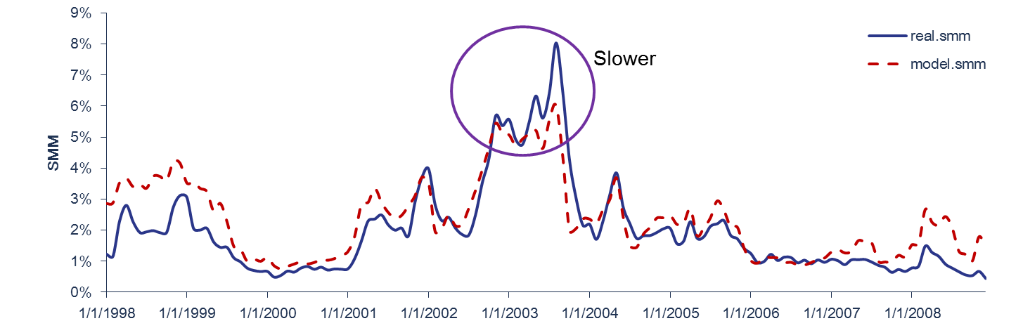
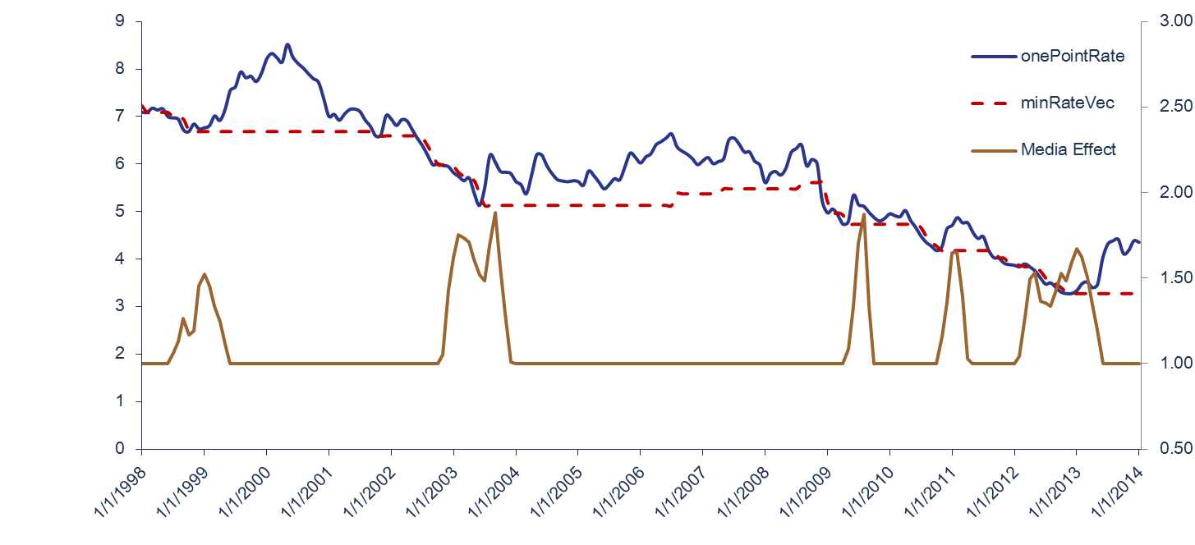
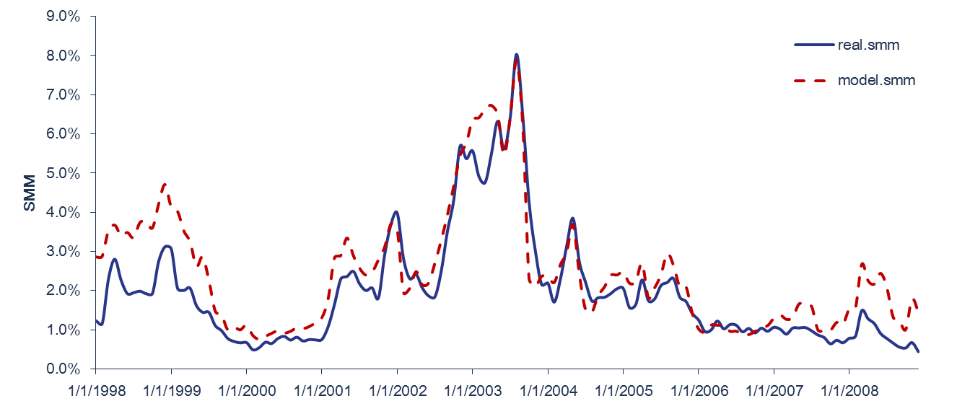
Media Effect and Credit Availability
Media Effect – Meet the Refinance Wave
Mortgage borrowers tend to refinance more aggressively than usual when rates hit multi-year lows.
Model prepay speed is slower in 2003
Reason:
Media effect
Solution:
Media effect multiplier
Result:
Meet Refi Wave 2013
DeltaPMMS30 = max(lowest PMMS in past 3 years not including this month - PMMS this month + rate buffer, 0)
DeltaPMMS30_MA = 3-month moving average of DeltaPMMS30.
Media effect multiplier = max(5 * DeltaPMMS30_MA at three month earlier, 1.0)
Rate Changes and Media Effect
Fitting Result after Media Effect

Slide 12
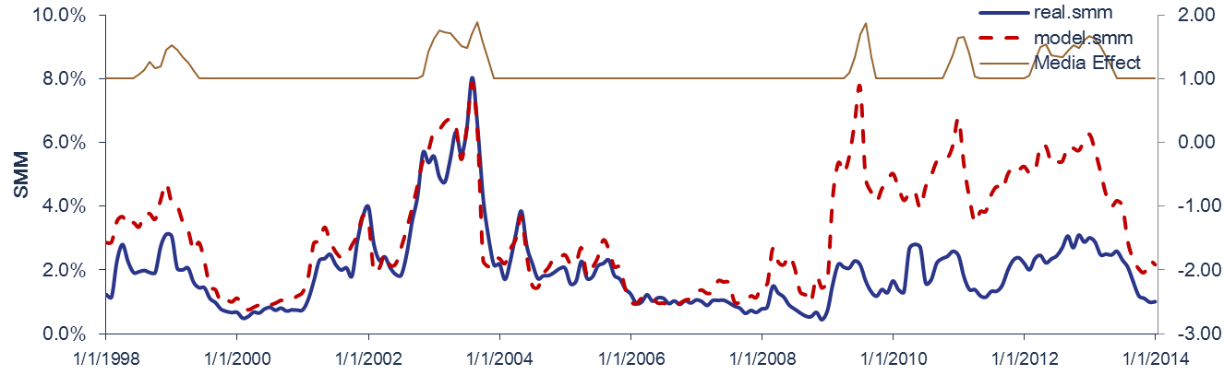
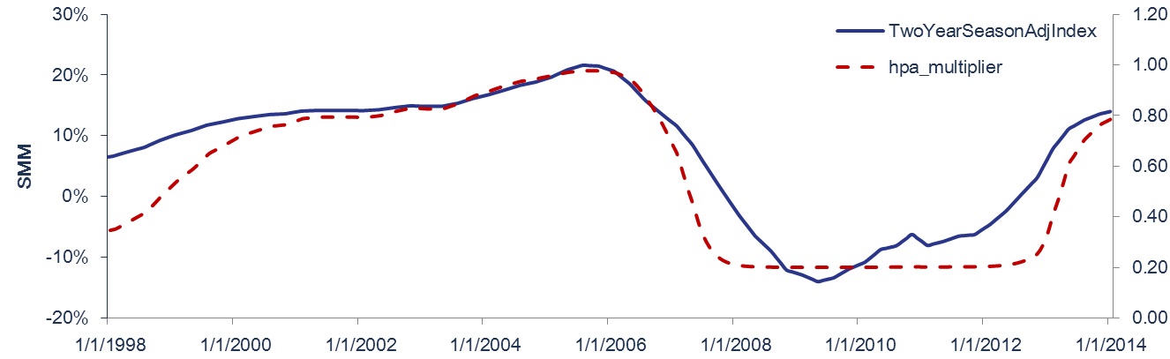
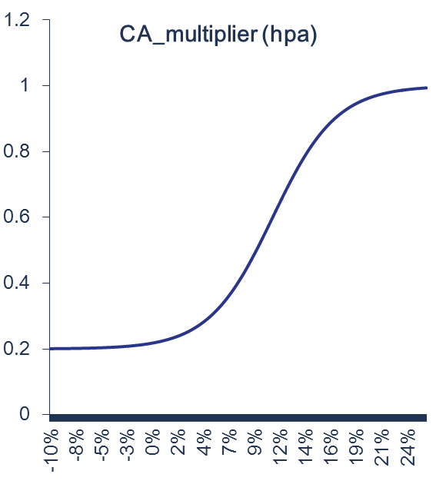
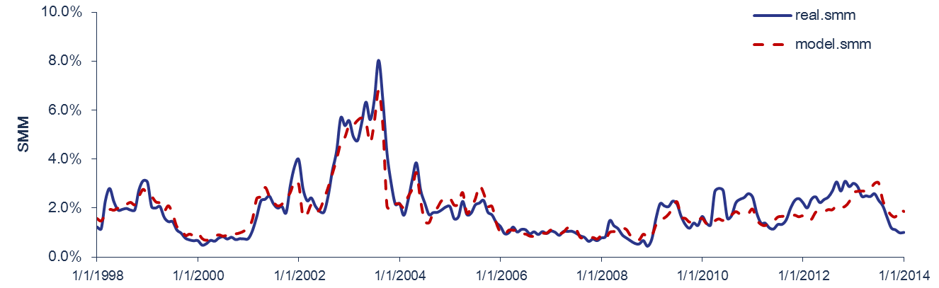

Media Effect and Credit Availability
Credit Availability
Model SMM is too fast after 2008
Using same Media Effect model
Another factor need to be involved for the house market.
$$CA=1− α/(1 +e^((hpa2yr − β)/γ)$$
Good overall fitting result from 1998 to 2014

Slide 13
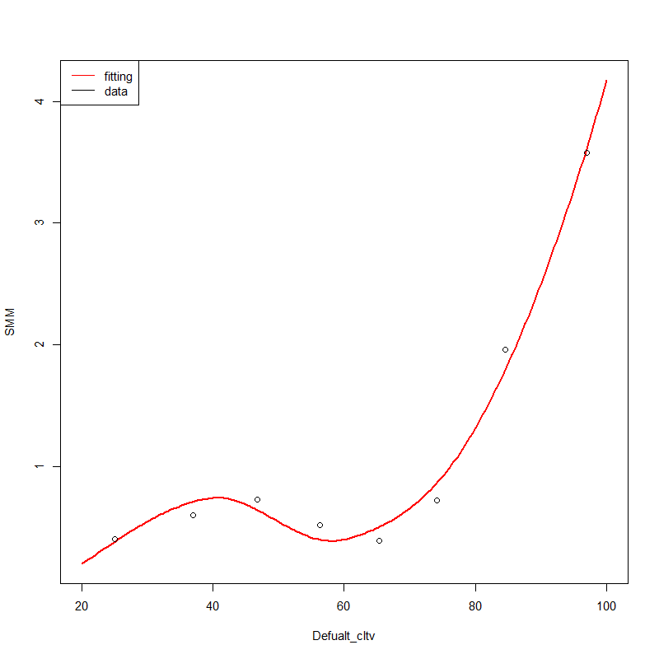
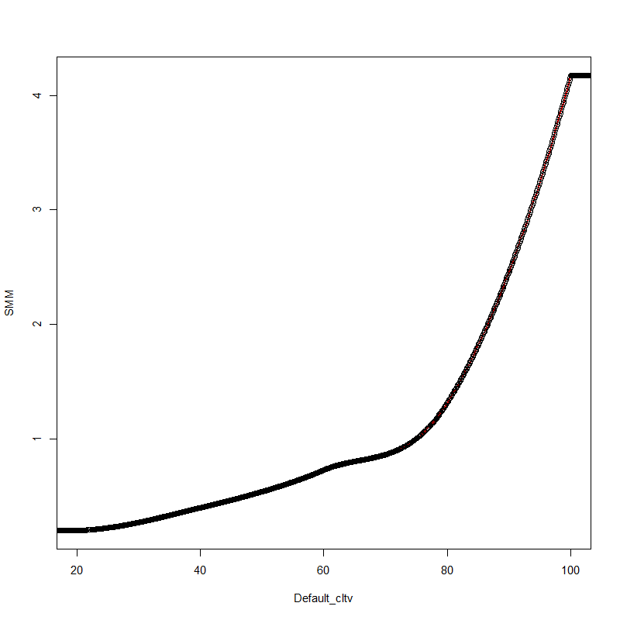
Model Improvements Change smooth spline to monotonic Hermite spline
Cubic Spline
smooth.spline
Derivative discontinuous when use few knots
natural spline
First derivative continuous, poor local control, no monotonic feature
Hermite spline
First derivative continuous, piecewise cubic strong local contral,
monotonic feature
Previous
First derivative continuous
Monotonic
Change Hermite spline, re-check the raw data, fulfill monotonic condition.

Slide 14
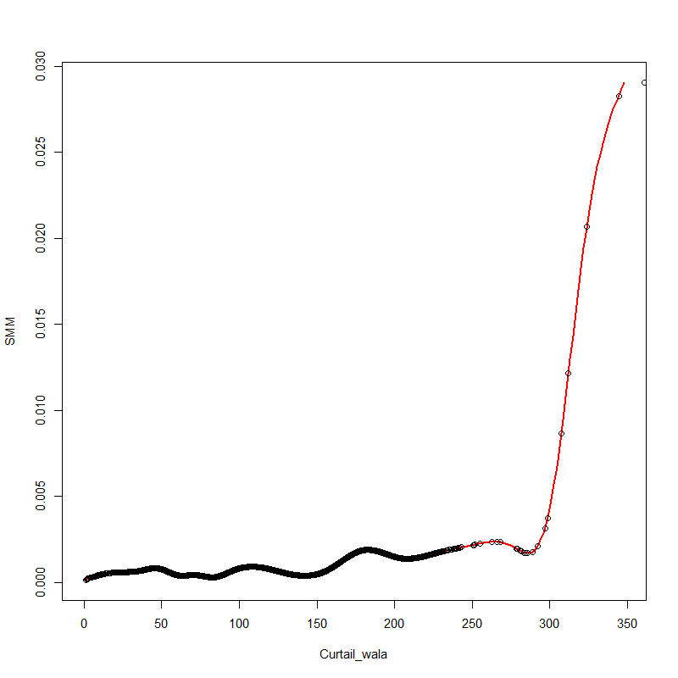
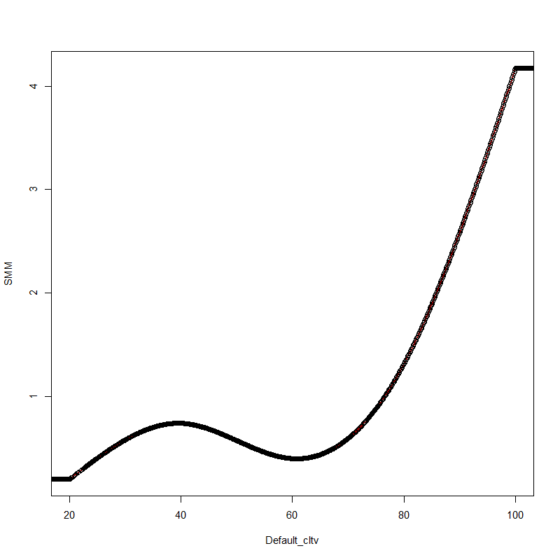
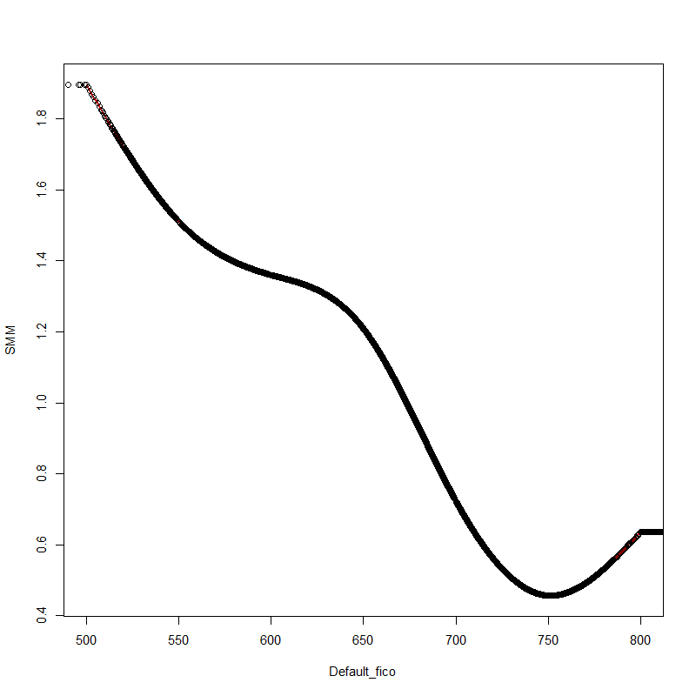
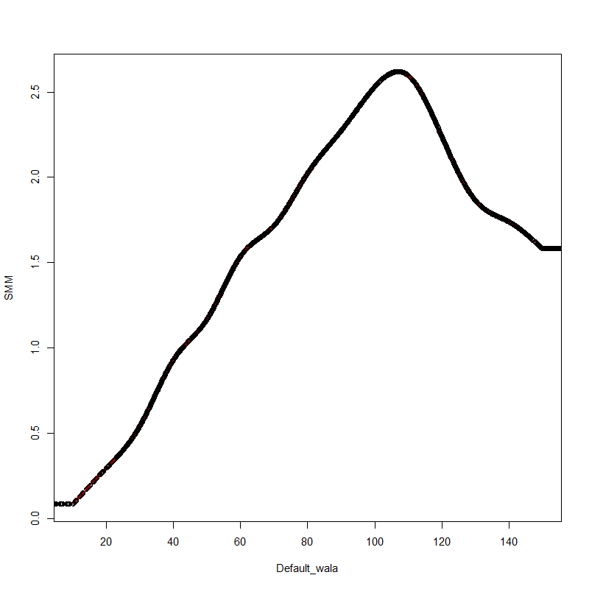
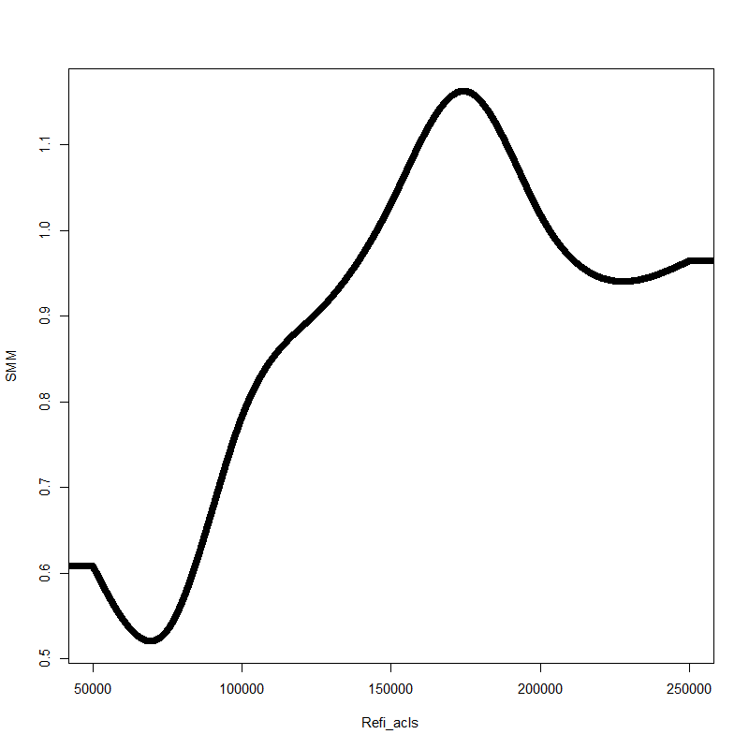
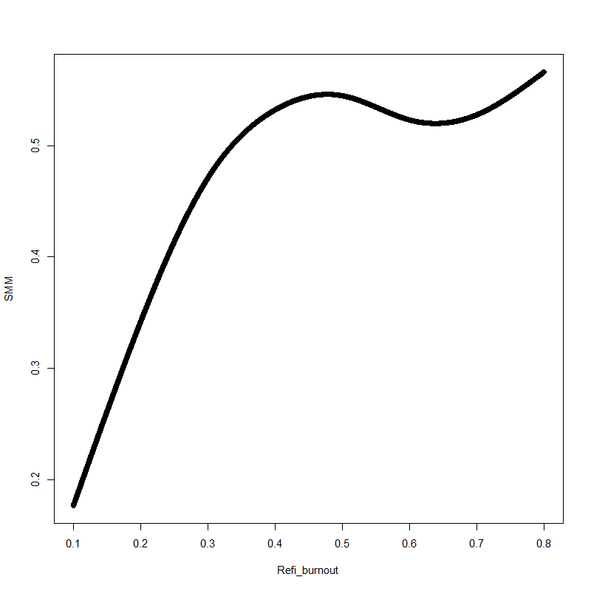
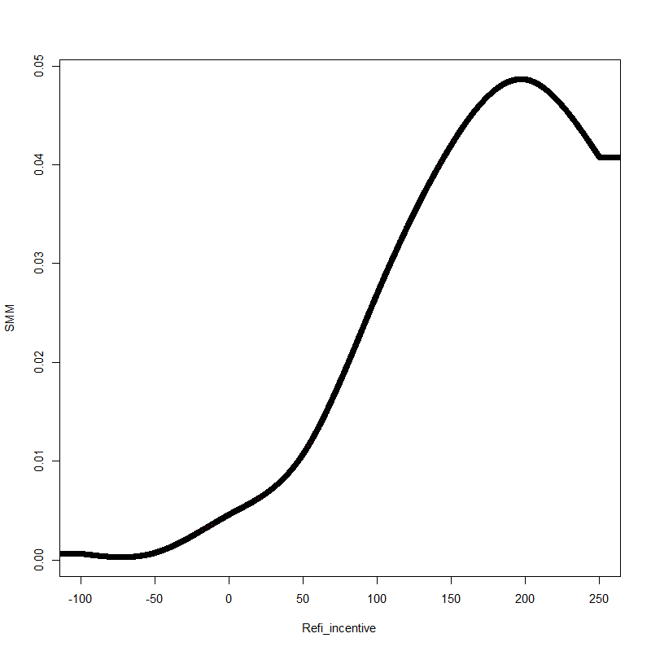
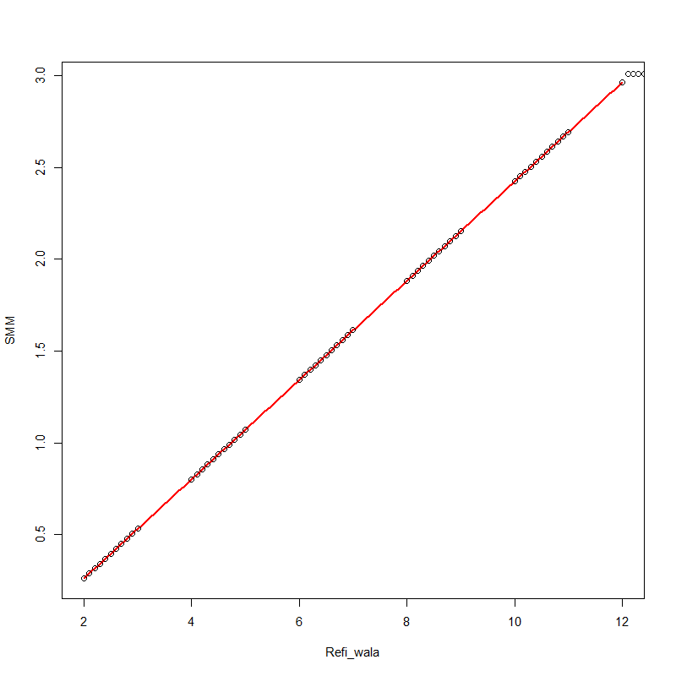
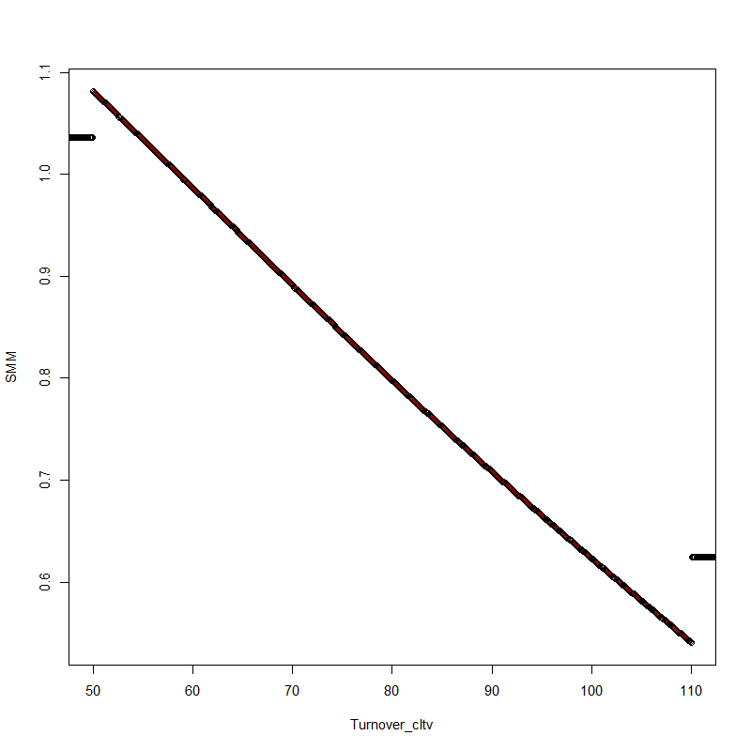
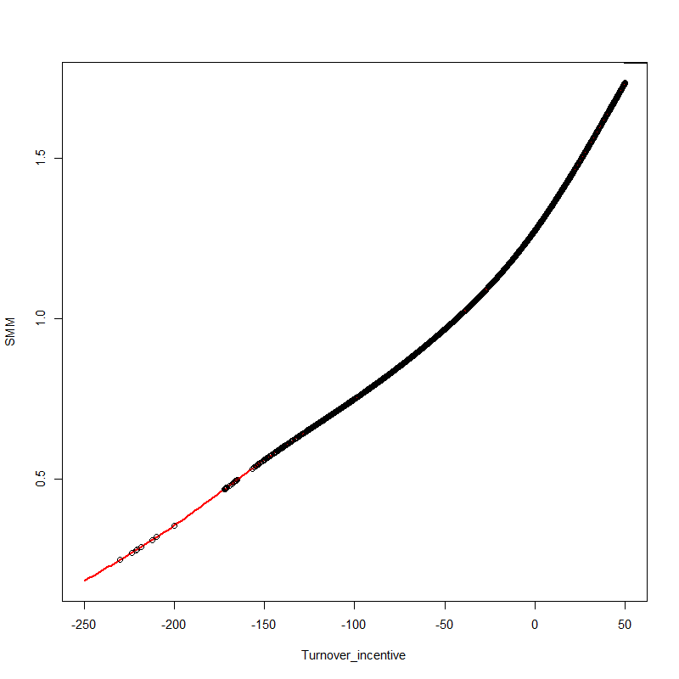
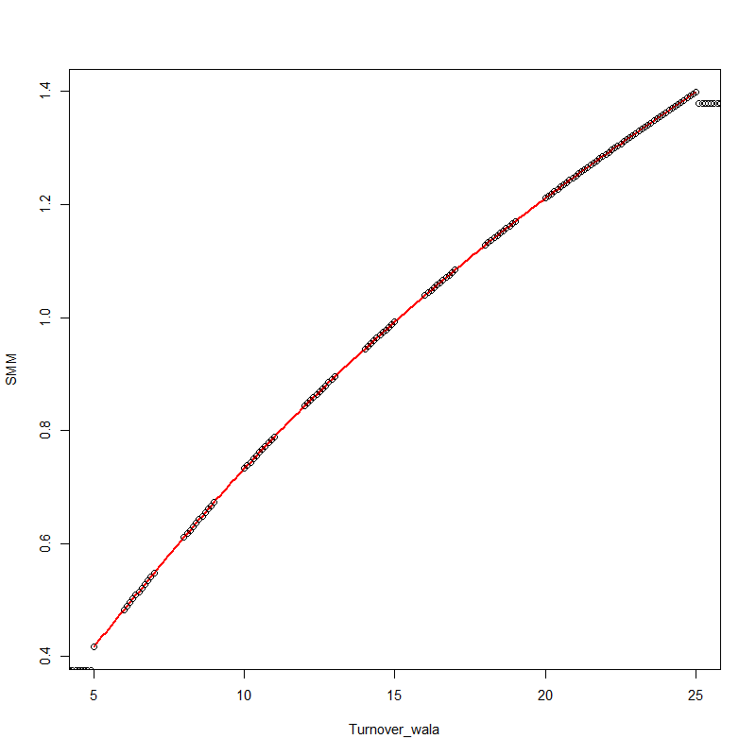
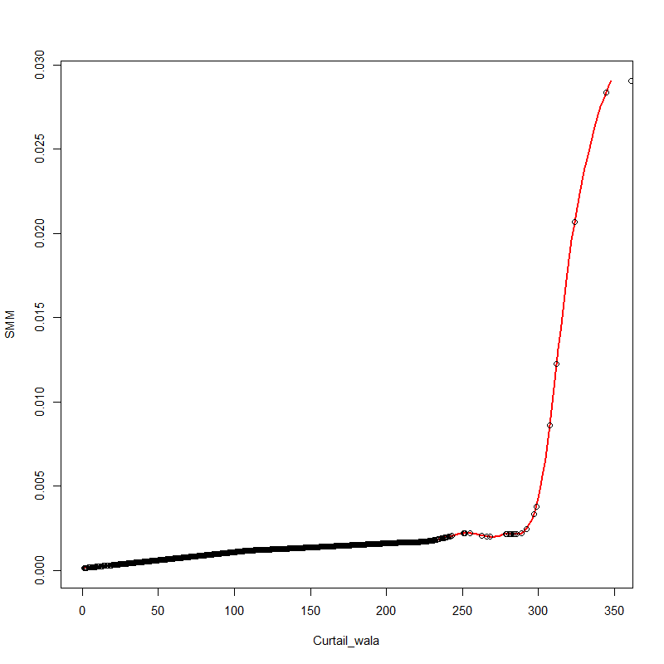
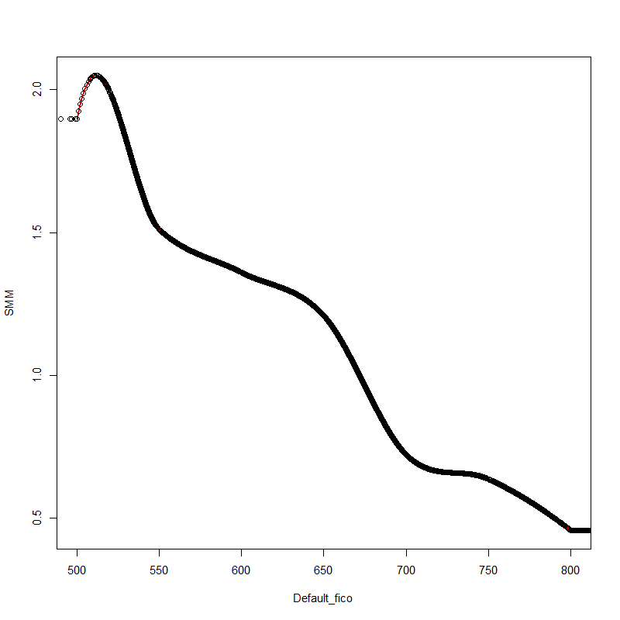
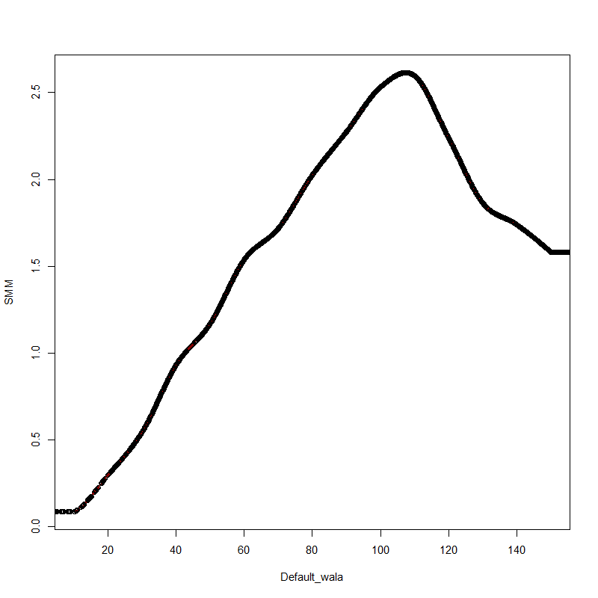
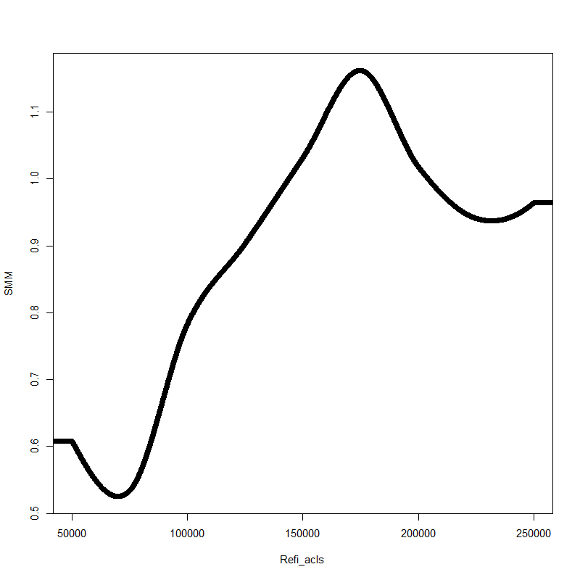
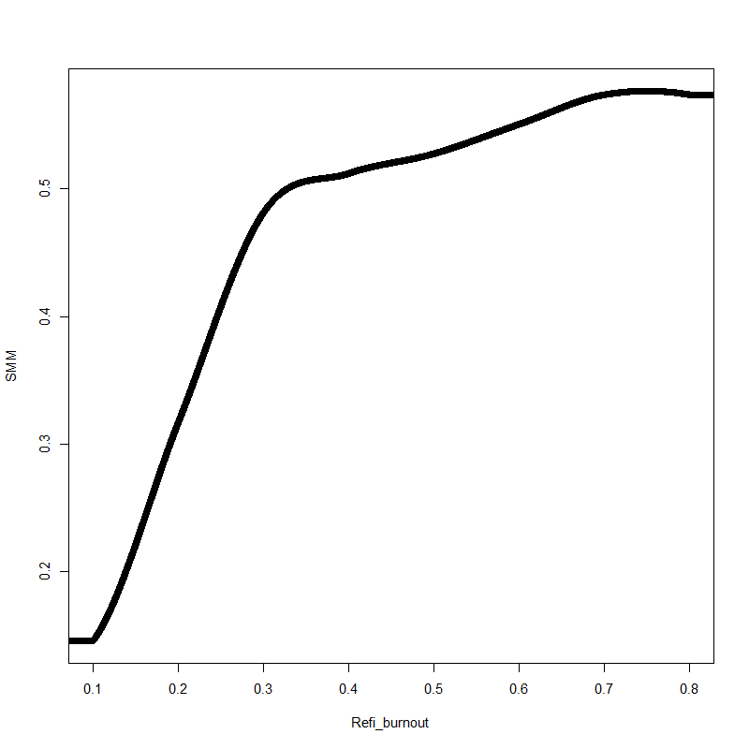
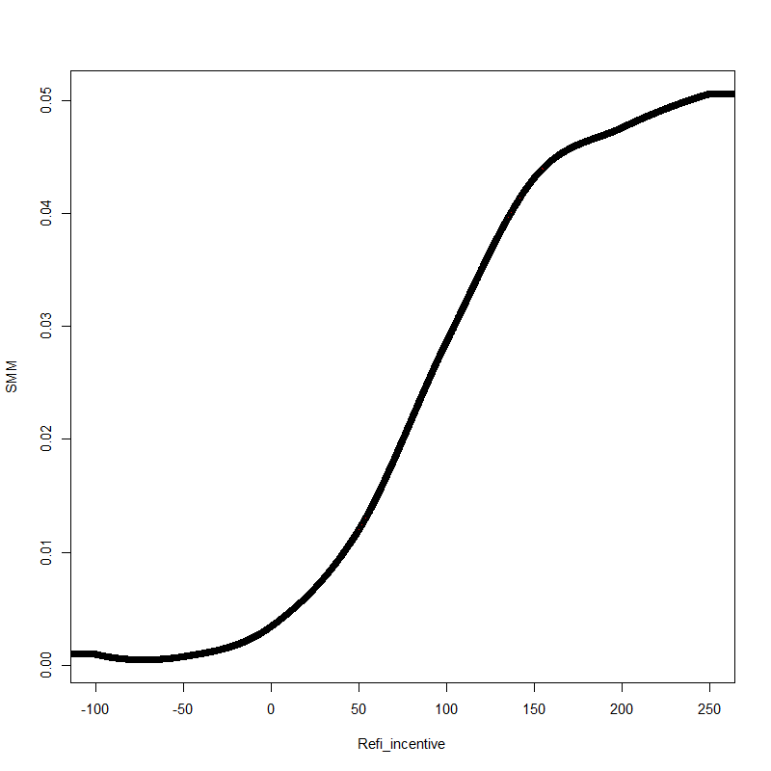
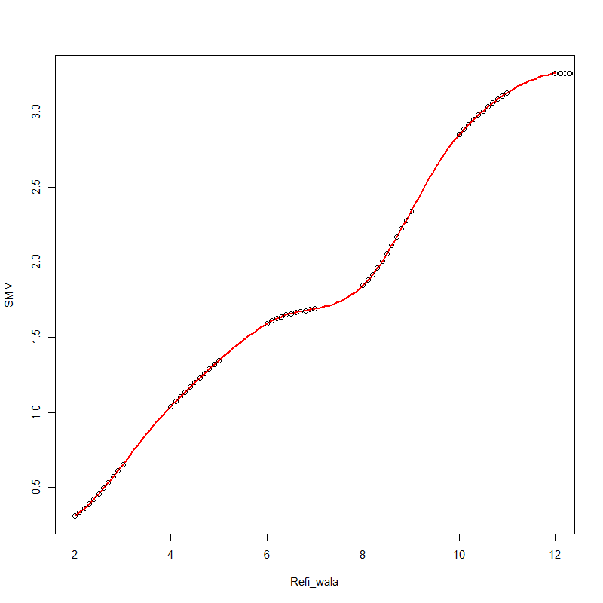
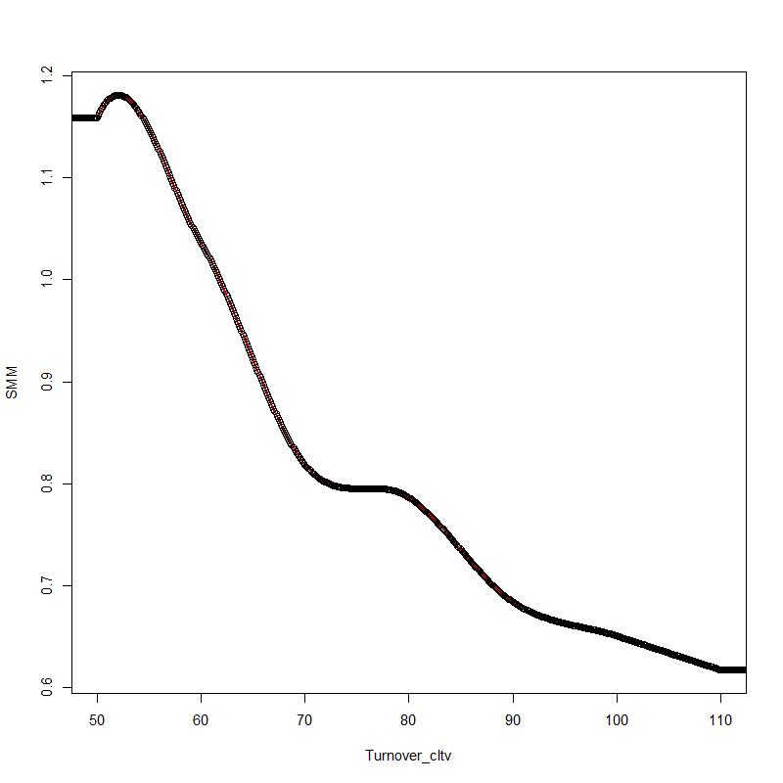
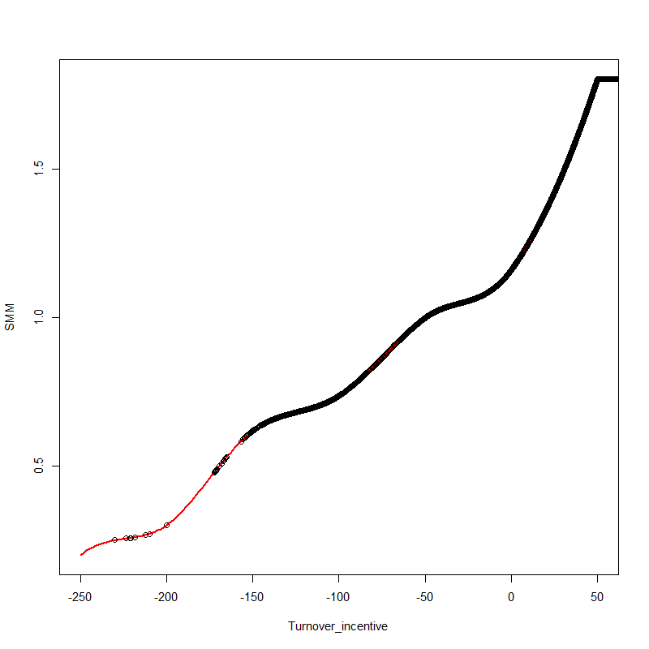
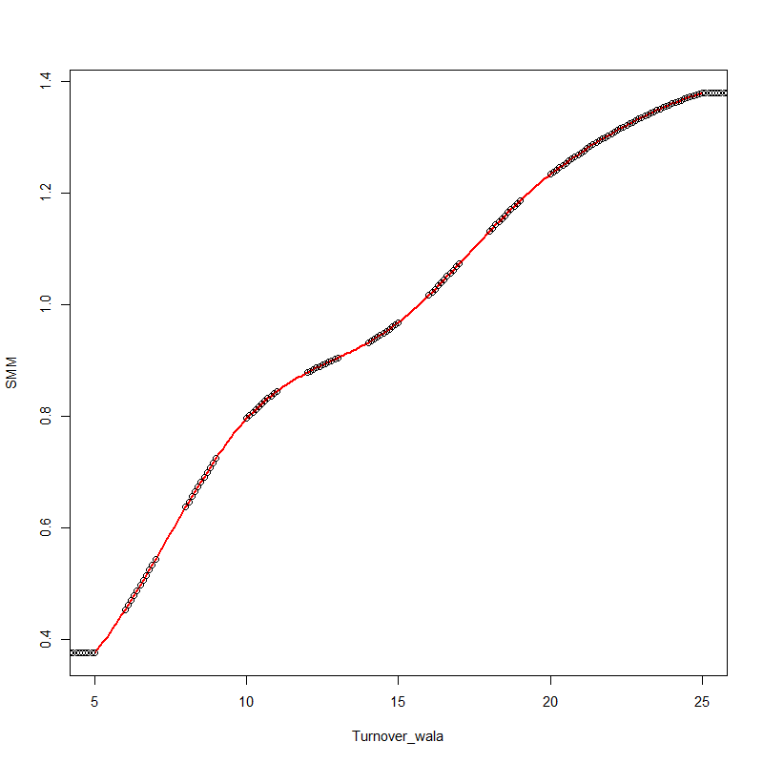
Model Improvements Change smooth spline to monotonic Hermite spline
Before
Curtail_wala
Default_cltv
Default_fico
Default_wala
Refi_acls
Refi_burnout
Refi_incentive
Refi_wala
Turnover_cltv
Turnover_incentive
Turnover_wala
After
Curtail_wala
Default_cltv
Default_fico
Default_wala
Refi_acls
Refi_burnout
Refi_incentive
Refi_wala
Turnover_cltv
Turnover_incentive
Turnover_wala

Slide 15
Model Improvements Remove “jump up” problem in media effect
Consider a situation when rate stay constant for 3 years
=rate buffer
=0
DeltaPMMS30 = max(lowest PMMS in past 3 years not including this month - PMMS this month + rate buffer, 0)
DeltaPMMS30_MA = 3-month moving average of DeltaPMMS30.
Media effect multiplier = max(5 * DeltaPMMS30_MA at three month earlier, 1.0)
=5 * rate buffer
If (5 * rate buffer) > 1, Media effect multiplier will unexpectedly jump up
Solution: set rate buffer boundary no larger than 0.2
Check fitting error:
 | Rate Buffer | Fitting Error
Previous buffer | 0.25 | 0.673184642
New buffer | 0.2 | 0.666360687
Min error | 0.2301195 | 0.651605852

Slide 16
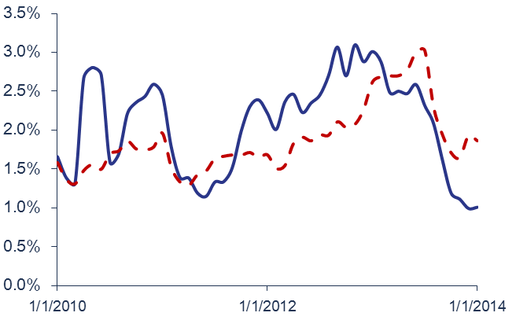
Model Improvements Change Credit Availability measure, Improve Recent Years Fitting
Fitting Quality Decrease After 2010
0.9% fitting error
Overall fitting result is acceptable, but resent years results show a larger error.
Error in 2004 even increase to 0.9% SMM.
Review HPA Model
HPA measure shows a higher prediction SMM in recent 2 yrs.
More strict underwriting criteria
Need to find a credit availability measure with thin tail

Slide 17
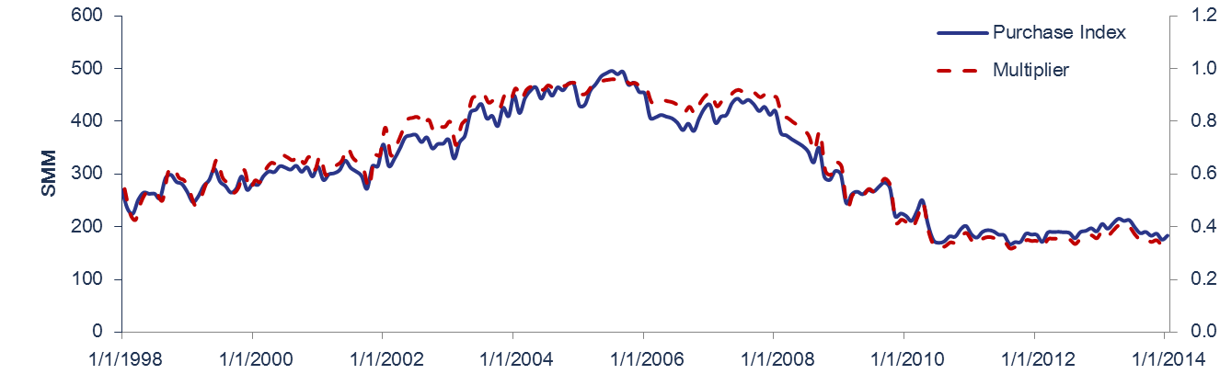
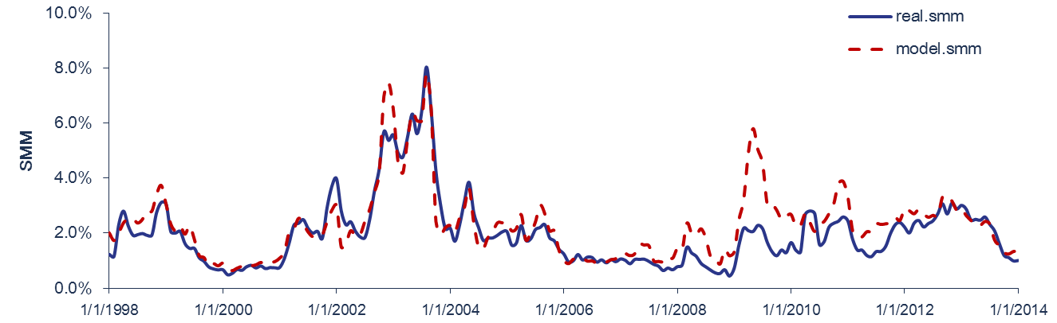
Model Improvements Change Credit Availability measure, Improve Recent Years Fitting
Purchase Index
Changed credit availability
Using MBAVPRCH Purchase Index instead of HPA
$$CA=1− α/(1 +e^((purchase − β)/γ)$$
Get a right model shape: thin tail in recent 2 years
Problem:
Purchase index is sensitive to mortgage rate.
Multiplier decrease slow in 09’ to 10’.

Slide 18
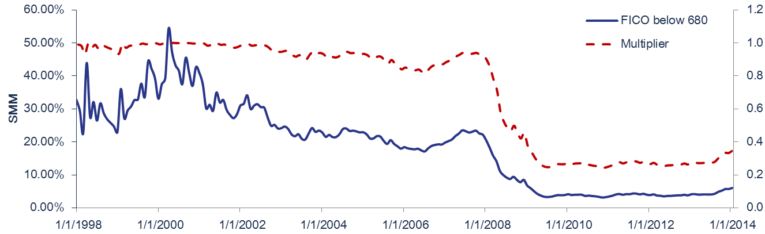
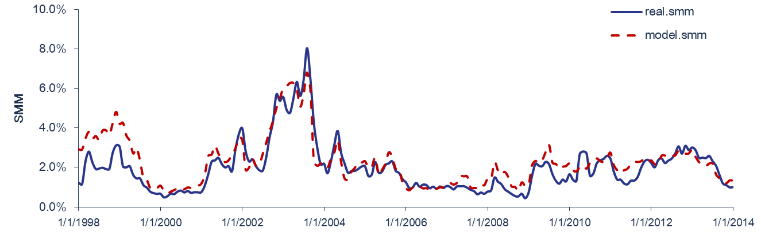
Model Improvements Change Credit Availability measure, Improve Recent Years Fitting
FICO Distribution Measure
Borrowers in purchase activities is sensitive to mortgage rate, so using purchase index to directly measure credit availability may brings bias.
Consider another measure: percentage distribution of FICO score
e.g.: Percentage for borrowers’ FICO below 680 is 22.55% in Nov. 2007;
this number decrease to 3.29% in July 2009.
Get a less rate-sensitive measure for credit availability.
High overall fitting quality;
Errors in recent years keep low.

Slide 19
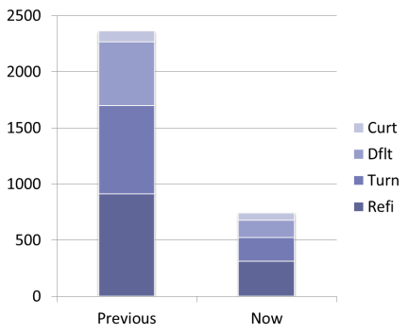
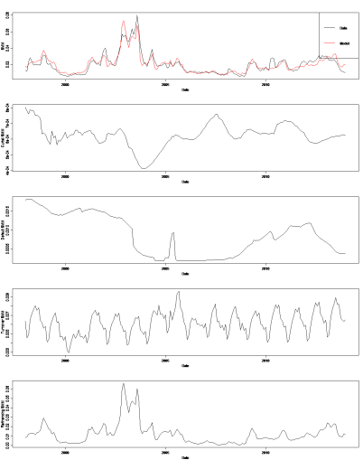
Model Improvements Efficient R-Script
Code Efficiency
Made every sub-component/functional calculation process a function:
Refinancing model: reduce from 913 lines to 310 (reduce by 66%)
Turnover model: from 783 to 212 (reduce by 73%)
Default model: from 567 to 156 (reduce by 72%)
Curtailment model: from 98 to 65 (reduce by 34%)
Total reduce: from 2361 to 743 (reduce by 68.5%)
Remove manual execution: only need to call one function for each component
easy to add/delete factors in sub-model
easy to change functional calculation method
Remove most loop calculation: Loop in R is the most time consuming part
change loops with matrix function
New Features
Visualize the quality of sub-model fitting across various prepayment data.
Building spline function:
Includes 3 different spline function, easy to choose:
Smooth spline
Natural spline
Hermite spline

Slide 20
Version Review
R Script Folder | Description | Final Changed Date
ppmRCode_1.2 | Bin's latest version
ppmRCode_1.2.1 | Previous Version: ppmRCode_1.2; Bug fixed: manual copy wrong parameters; finished the 2nd time spline optimization using least square optimal results. | 7/9/2014
ppmRCode_1.3 | Previous Version: ppmRCode_1.2.1; make every fitting and tracking components a function, easy to add or delete factors; reduce loop calculations; Provide same result as folder ppmRCode_1.2.1. local storage raw data and calculation data, easy to track; | 7/17/2014
ppmRCode_1.3.1 | Previous Version: ppmRCode_1.3; Change spline function(from smooth to hermite) for tracking function; Research on media effect and credit availability. | 8/6/2014
ppmRCode_1.3.1/ME1 | Check the model without media effect and HPA
ppmRCode_1.3.1/ME2 | Changed Media Effect parameters, removed "jump up" problem after 3 yrs constant rate
ppmRCode_1.3.1/ME3 | Changed credit availability by modify HPA parameters. HPA measure shows a higher prediction smm than actual in recent 2 yrs. Due to much more strict underwriting criteria, we might need to find a credit availability measure other than HPA.
ppmRCode_1.3.1/ME4 | Changed credit availability, get a right model shape by using Purchase Index instead of HPA, though MBAVPRCH index is sensitive to mortgage rate.
ppmRCode_1.3.1/ME5 | Changed credit availability, get a less rate-sensitive measure for credit availability by constructing a distribution of FICO score in all purchases.
ppmRCode_1.3.2 | Previous Version: ppmRCode_1.3.1; Changed the Pool level model to add a feature to fit the single pool AE5463; Tie out with C++ program result from CCMPrepayModel_v1.2.2. | 8/6/2014
ppmRCode_1.3.3 | Previous Version: ppmRCode_1.3.2; Test version for pool: MA1291 (Fannie Mae) CLTV>100, turnover SMM shows negtive number in C++ v1.2.2 and v1.2; turn is higher in 1.2.1. | 8/8/2014
ppmRCode_1.4 | Previous Version: ppmRCode_1.3.1; Changed the spline function from smooth spline to Hermite cubic spline in fitting; plot all the tracking curves and fitting curves; remove "*0.5" multiplier in default model fico factor . | 7/31/2014
ppmRCode_1.5 | Previous Version: ppmRCode_1.4; Modified knot values to fulfill the conditions for monotonic spline. | 8/4/2014
ppmRCode_1.5/ME5 | Changed credit availability for new refi data generated from new spline function

Slide 22
Improvement on media effect

Slide 25
CONTACT INFORMATION For further information, please contact:
Thank You

Slide 26
DISCLOSURES Important Notes
THIS DOCUMENT IS NOT AN OFFER TO SELL OR THE SOLICITATION OF AN OFFER TO BUY SHARES OF THE FUND. AN OFFERING OF INTERESTS WILL BE MADE ONLY BY MEANS OF A CONFIDENTIAL PRIVATE PLACEMENT MEMORANDUM AND ONLY TO QUALIFIED INVESTORS IN JURISDICTIONS WHERE PERMITTED BY LAW. PAST PERFORMANCE IS NO GUARANTEE OF FUTURE PERFORMANCE.
An investment in the Fund is speculative and involves a high degree of risk. The Fund will have substantial limitations on investors’ ability to redeem or transfer their shares, and no secondary market for the Fund’s shares exists or will develop. All of these risks, and other important risks, are described in detail in the Fund’s Confidential Private Placement Memorandum. Prospective investors are strongly urged to review this Confidential Private Placement Memorandum carefully and consult with their own financial, legal and tax advisors, before investing.
Portions of this document may contain commentary and/or data based on certain current assumptions by Cello Capital Management, LP(“Cello”), which are subject to change at any time, as well as Cello's internal complex calculations. If one or more of these assumptions or calculations is incorrect, the information contained herein may unintentionally be inaccurate.
Certain information contained herein may have been obtained by Cello from third parties. While Cello believes such sources are reliable, Cello has not verified the accuracy of such information and shall not be liable for any errors in such information or for any actions taken in reliance thereon.
This document may also contain certain forward looking statements and projections. Such statements and projections are subject to a number of assumptions, risks and uncertainties which may cause actual results, performance or achievements to be materially different from future results, performance or achievements expressed or implied by these forward-looking statements and projections. Prospective investors are cautioned not to invest based on these forward-looking statements and projections.
This document may contain references to certain internal Cello procedures and policies which are subject to change at any time.
No information or material contained herein may be reproduced, transmitted, displayed or commercially exploited without the prior written consent of Cello. All rights are reserved.

